Slide 1


Java String:
A SHORT OVERVIEW TO JAVA STRING:
By : Raghav Panthi

Slide 2
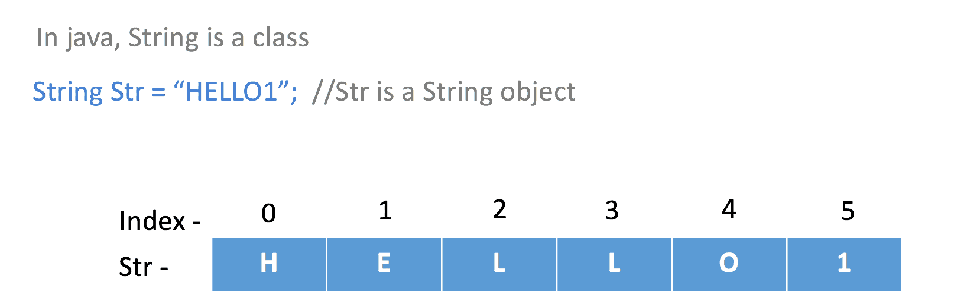
Introduction to Strings
A sequence of characters that start and enclosed in double quotes. (character array)
They can also called object.
They are immutable object.(cannot be change).

Slide 3

Creating Strings
There are two ways to create String Object:
Using String literal
Memory view:
A
String A=“RAM”;
String B=“RAM”;
String C=B;
B
0 1 2
C
R
A
M
when we create a new variable with same String in this condition, they refer to the same string object in the pool.
R
A
M
L
A
L
Special condition:
String constant Pool.
A=A.concat(“LAL”);
A
old A is removed
Here when we want to change the String object in this condition new place is created Java String is immutable.
Heap Memory

Slide 4
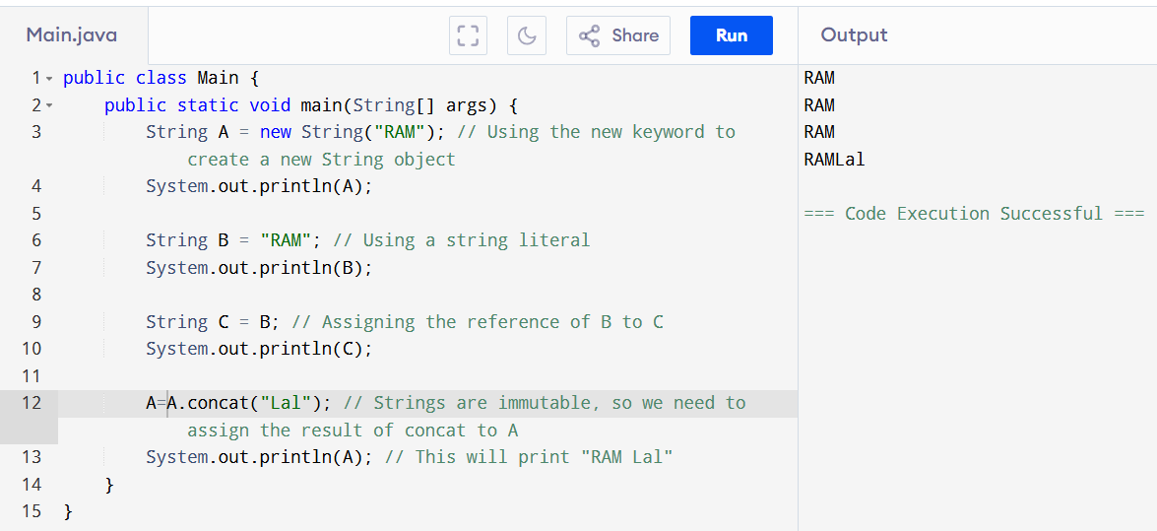
Example of string literal.

Slide 5
Using new keyword.
String A=new String(“RAM”);
Memory view:
They are also final .cannot be change
Special condition:
A.concat(“LAL”);
String constant Pool.
When we concat the A due to the new key word there will be no change in string
A
0 1 2
R
A
M
Heap Memory

Slide 6
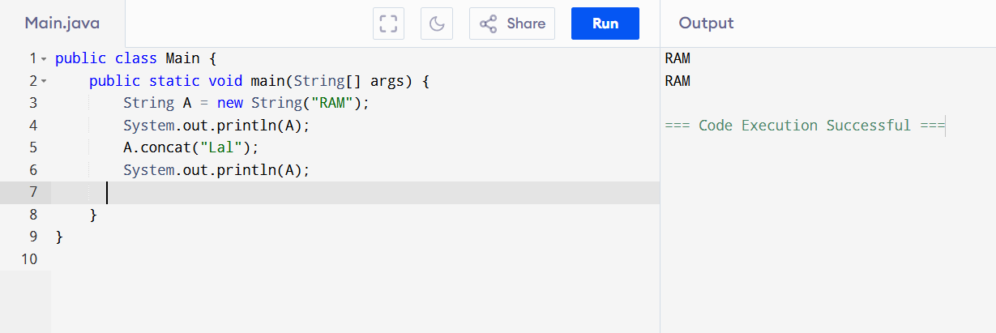
Example of new keyword.
Due to string is immutable.

Slide 7
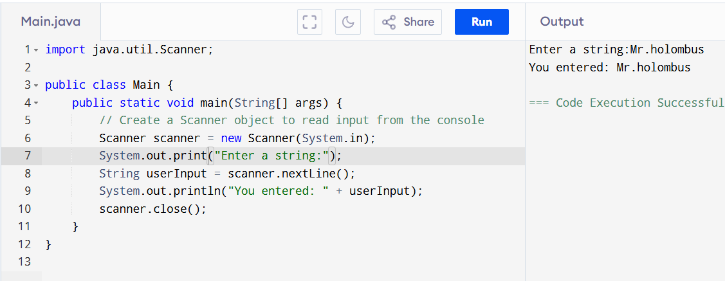
Taking String as input :

Slide 8

Useful String function:
String Length
The length() method in Java is used to determine the number of characters present in a string characters (including the space).. The syntax is: int length = string.length();
Example
String greeting = "Hello World";
System.out.println("Length of the string: " + greeting.length());
// Output: Length of the string: 11

Slide 9
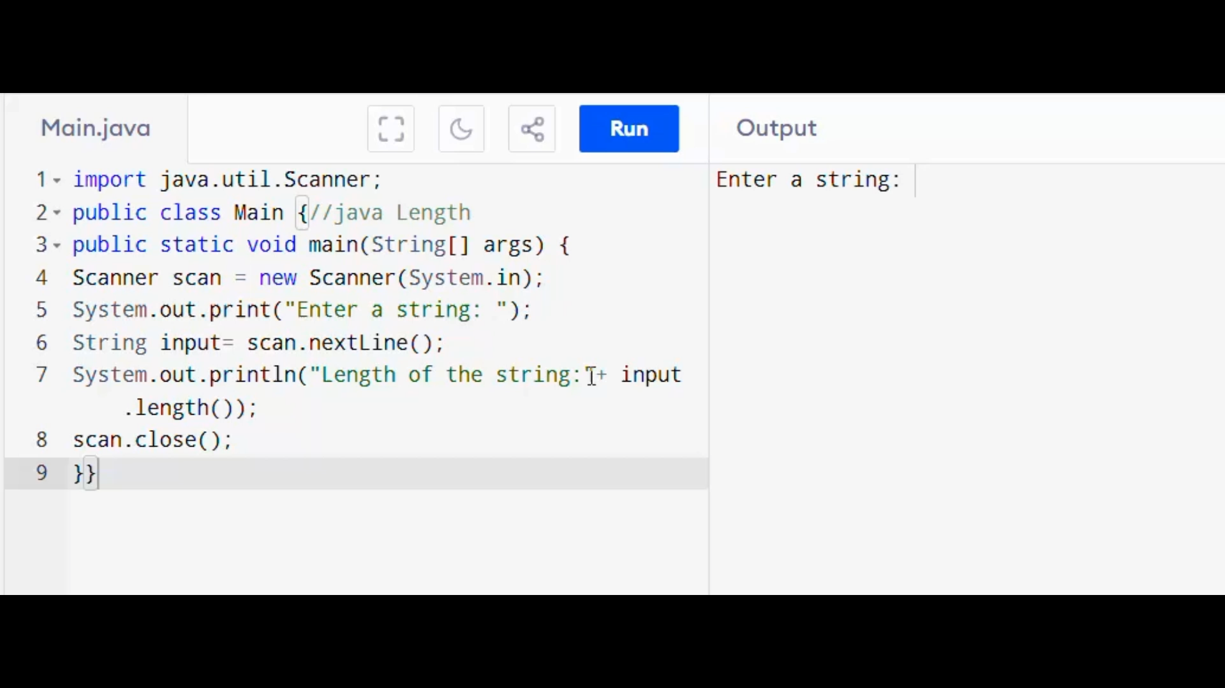
Example of String length :

Slide 10

String Comparison
Java provides multiple ways to compare strings. Two common methods are using the == operator and using the equals() method.
1
Using == Operator
2
Using .equals() Method
The equals() method compares the actual content of two strings, returning true if the contents are the same and false otherwise.
The == operator compares the references(address) of the two strings, not their actual values.
If two strings refer to the same object, == returns true; otherwise, it returns false.

Slide 11
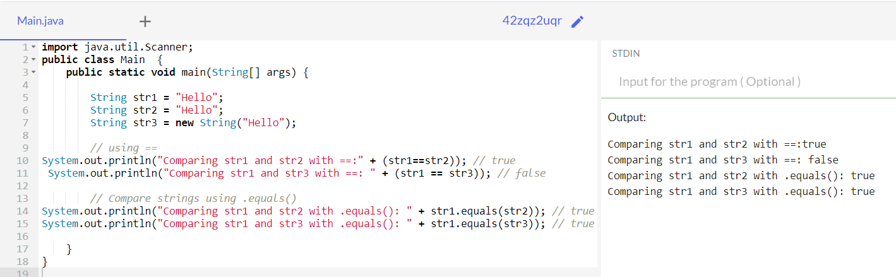

Slide 12
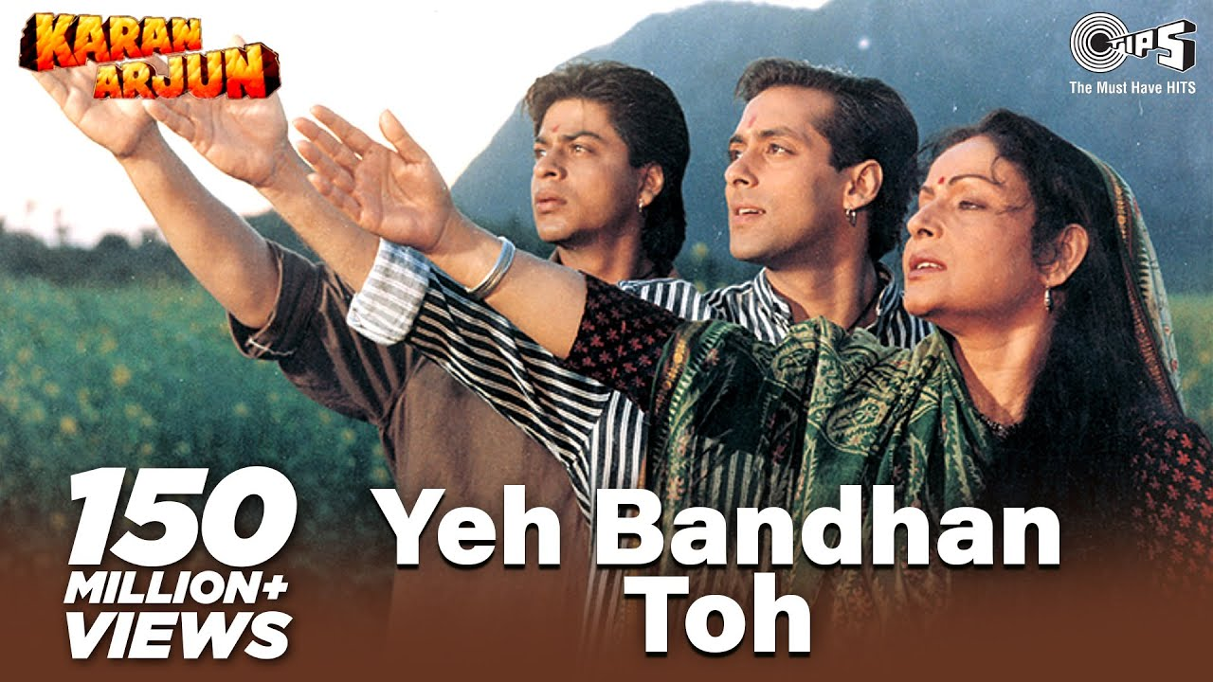
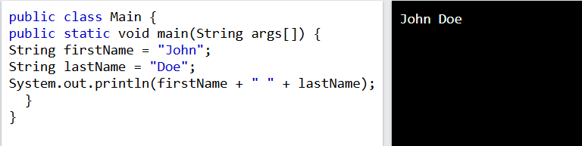
String Concatenation
In Java, you can concatenate (join) two or more strings using the + operator or the concat() method.
However, using + for concatenation is less efficient compared to StringBuffer or StringBuilder.
Using + Operator
When you concatenate strings using +, Java internally uses a StringBuilder to perform the concatenation.
This can be inefficient because new objects are created each time you concatenate a string.

Slide 13
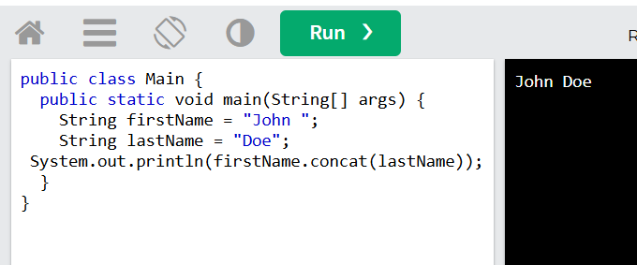
Using concat() method;
Note: For efficient string concatenation, especially in loops or repeated operations, it is better to use StringBuffer or StringBuilder.

Slide 14
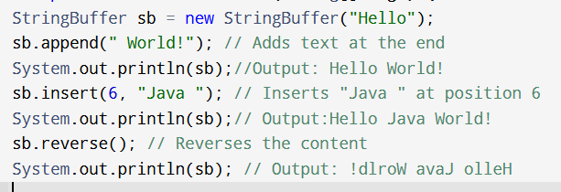
StringBuffer
A StringBuffer is a mutable sequence of characters.
It allows modifications like appending, inserting, delete, or reversing characters.
All methods are synchronized, ensuring safe usage in multithreaded environments.
Common Methods in StringBuffer
append(String str): Adds a string at the end.
insert(int offset, String str): Inserts a string at a specified position.
delete(int start, int end): Removes characters between specified indices
reverse(): Reverses the character sequence.
Note : Threads are used to perform complicated tasks in the background without interrupting the main program.

Slide 15
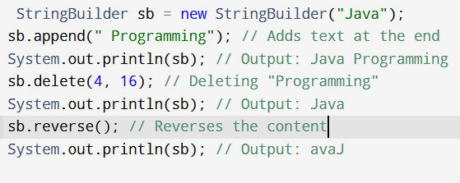
StringBuilder
A StringBuilder is similar to StringBuffer but not thread-safe.
Faster than StringBuffer in single-threaded applications due to the absence of synchronization.
Common Methods in StringBuilder
append(String str): Adds a string at the end.
insert(int offset, String str): Inserts a string at a specified position.
delete(int start, int end): Removes characters between specified indices
reverse(): Reverses the character sequence.

Slide 16



Use Stringbuilder
When to Use Which
Use Stringbuffer
Both StringBuilder and StringBuffer serve
the same purpose of modifying strings efficiently.
Thread-Safety Required?
Yes: Use StringBuffer. To synchronized.
No: Use StringBuilder
Faster in single-threaded environments.

Slide 17

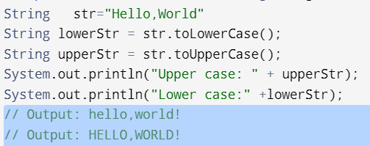
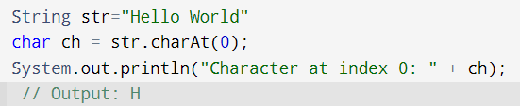


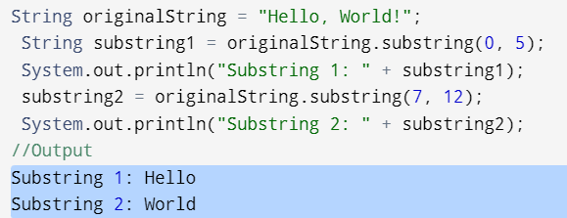
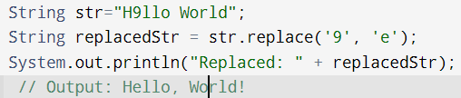
More string function
^
^
To Lower or Upper Case
charAt(int index)
Use the toLowerCase() or toUpperCase() methods
to convert a string to uppercase or lowercase .
Returns the character at the specified index..
substring
replace
Returns a substring from the specified begin index to
the specified end index.
Replaces occurrences of a specified character with another character.

Slide 18


